Slide 1
Body Image
Body Types & Eating Disorders

Slide 2
Go to https://www.myfooddiary.com/
Take out your food diary and enter in each food item that you ate to find out how many calories each item contained.
Fill in the calorie portion of your log and total the number of calories for each day.
If the Food was homemade, find a recipe for it and enter it into https://www.verywellfit.com/recipe-nutrition-analyzer-4157076
to find the Calories
How does your calorie intake compare to what you need to burn based on your calculations yesterday?

Slide 3
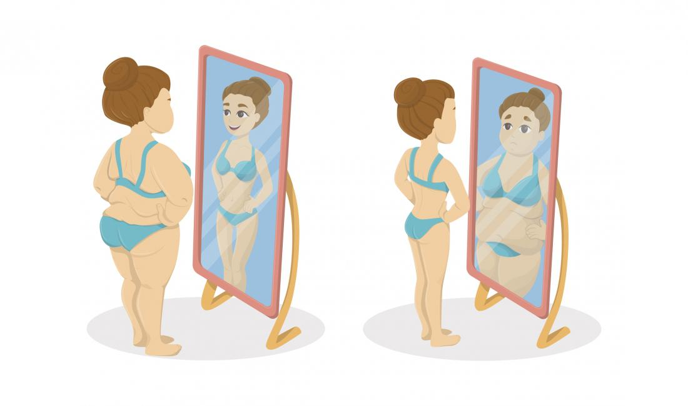
Body Image
Refers to the mental picture an individual has of his/herself

Slide 4
Healthy Body Image
Involves having a greater appreciation for oneself and others!
Accepting certain aspects of one’s body structure and shape that are genetic and cannot be changed.

Slide 5
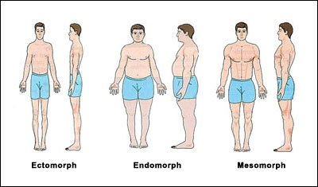
Body Types are determined by genetics
Mesomorph
Endomorph
Ectomorph

Slide 6
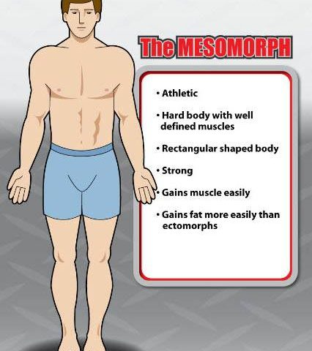
Mesomorph
Wide shoulders
Narrow hips
Long, round muscle bellies
Thinner joints

Slide 7
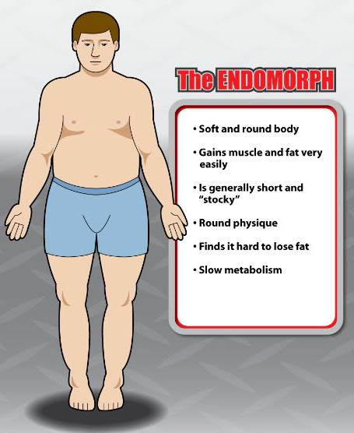
Endomorph
Thicker joints
Thick rib cage
Hips are wider than shoulders
Shorter limbs

Slide 8
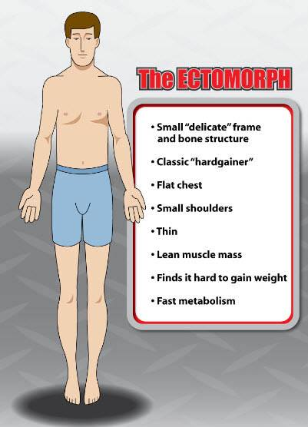
Ectomorph
Narrow shoulders and hips
Small joints
Thin build
Long limbs with stringy muscle bellies

Slide 9
Eating Disorders
Eating disorders are not just about food. They are often a way to cope with difficult problems or regain a sense of control. They are complicated illnesses that affect a person’s sense of identity, worth, and self-esteem (Canadian Mental Health Association).

Slide 10
Myths About Eating Disorders
https://www.youtube.com/watch?v=Qp80hbqBrfQ

Slide 11
Muscle Dysmorphia – The Male Eating Disorder | Scott Griffiths | TEDxSydney
https://www.youtube.com/watch?v=vs7nKcPsAXI
a psychological disorder marked by a negative body image and an obsessive desire to have a muscular physique.
It is characterized by
Excessive time and over-exertion in weightlifting to increase muscle mass
Preoccupation and panicking over workout if unable to attend
Overtraining or training when injured

Slide 12
Disordered eating, using special diets or excessive protein supplements
Steroid abuse and often other substance misuse
Distress if exposed leading to camouflage the body
Compulsive comparing and checking of one’s physique
Significant distress or mood swings
Prioritizing one’s schedule over all else or interference in relationships and ability to work
Often other body concerns, hair, skin, penis size

Slide 13
Bulimia Nervosa
Binge eating conflicted by wanting to lose weight or be thin
Often leads to forceful vomiting, excessive dieting, or fasting.

Slide 14
Signs and Symptoms
Calluses or scars on the knuckles or hands from sticking fingers down the throat to induce vomiting.
Puffy “chipmunk” cheeks caused by repeated vomiting.
Discolored teeth from exposure to stomach acid when throwing up. May look yellow, ragged, or clear.
Not underweight – Men and women with bulimia are usually normal weight or slightly overweight. Being underweight while purging might indicate a purging type of anorexia.
Frequent fluctuations in weight – Weight may fluctuate by 10 pounds or more due to alternating episodes of bingeing and purging.

Slide 15
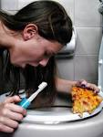
Effects
Weight gain
Dehydration
Abdominal pain, bloating
Swelling of the hands and feet
Chronic sore throat, hoarseness
Broken blood vessels in the eyes
Swollen cheeks and salivary glands
Weakness and dizziness
Tooth decay and mouth sores
Acid reflux or ulcers
Ruptured stomach or esophagus
Loss of menstrual periods
Chronic constipation from laxative abuse

Slide 16
Anorexia Nervosa
Refusal to maintain healthy body weight
Intense fear of gaining weight
Distorted body image

Slide 17
Signs and Symptoms
Dieting despite being thin – Following a severely restricted diet. Eating only certain low-calorie foods. Banning “bad” foods such as carbohydrates and fats.
Obsession with calories, fat grams, and nutrition – Reading food labels, measuring and weighing portions, keeping a food diary, reading diet books.
Pretending to eat or lying about eating – Hiding, playing with, or throwing away food to avoid eating. Making excuses to get out of meals (“I had a huge lunch” or “My stomach isn’t feeling good.”).
Preoccupation with food – Constantly thinking about food. Cooking for others, collecting recipes, reading food magazines, or making meal plans while eating very little.
Strange or secretive food rituals – Refusing to eat around others or in public places. Eating in rigid, ritualistic ways (e.g. cutting food “just so”, chewing food and spitting it out, using a specific plate).

Slide 18
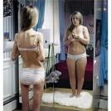
Effects
Severe mood swings; depression
Lack of energy and weakness
Slowed thinking; poor memory
Dry, yellowish skin and brittle nails
Constipation and bloating
Tooth decay and gum damage
Dizziness, fainting, and headaches
Growth of fine hair all over the body and face

Slide 19
Binge Eating Disorder
Frequent episodes of uncontrollable binge eating.
Feeling extremely distressed or upset during or after bingeing.
Unlike bulimia, there are no regular attempts to “make up” for the binges through vomiting, fasting, or over-exercising.

Slide 20
Signs and Symptoms
Inability to stop eating or control what you’re eating
Rapidly eating large amounts of food
Eating even when you're full
Hiding or stockpiling food to eat later in secret
Eating normally around others, but gorging when you’re alone
Eating continuously throughout the day, with no planned mealtimes

Slide 21
Effects
Type 2 diabetes
Gallbladder disease
High cholesterol
High blood pressure
Heart disease
Certain types of cancer
Osteoarthritis
Joint and muscle pain
Gastrointestinal problems
Sleep apnea

Slide 22
https://www.youtube.com/watch?v=f0tEcxLDDd4&ebc=ANyPxKpmwfXAc4BOAMswGb3LDzhksnkPXLz6XdgcEXpAI31DTHeRGXq3afZeHwLFmEvpEaNhxNsDF6yDm8nETJrrXTqcc_MbKA
Why do you think the kids had such different responses from the adults?
Why do you change as we get older?

Slide 23
https://www.youtube.com/watch?v=litXW91UauE
Why do you think peoples perceptions of themselves are so negative compared to what other people see?

